Slide 1

An undertaking of Bhaktapur Municipality KHWOPA COLLEGE OF ENGINEERING (Affiliated to Tribhuvan University) Libali - 8, Bhaktapur
Prepared By
Binita Shah
Indira Parajuli
Sanjit Kumar Thakur

Slide 2
Introduction
On-the-Job training (OJT) is a type of training that occurs in the workplace, rather than in a classroom or other learning environment.
It typically involves a trainee being given the opportunity to learn new skills and knowledge by working alongside more experienced colleagues, who can provide guidance and support as needed.
OJT is important not only to teach trainee regarding their chosen career but also to show trainee the reality about working. The trainee will be exposed to the actual work related to the course that they are taking.

Slide 3
Objectives
The goal of OJT is to help trainee develop the skills and knowledge they need to be successful in their job, while also benefiting the organization through increased productivity.
Helps to tackle different situations that may arise in the organization and be able to know how to socialize well with colleagues and develop good teamwork.

Slide 4
Skills Developed
Report Writing (Word)
Manipulation of Data (Excel)
format, organize and calculate data in a spreadsheet.
Presentation (PowerPoint)
Communicate with the audience through graphics, text or videos.
Networking (Cisco)
Database Design
Git
Coding (PHP, HTML, CSS, Cisco)

Slide 5
Microsoft Word
Basics of word (Fonts, Page Layout, Margin, Alignment, Bullets & Numbering)
Formatting, structures, referencing etc.
Mail Merge (e.g., ID Card)
Usage
Preparation of Report i.e., monthly reports.
ID Card creation using mail merge.

Slide 6
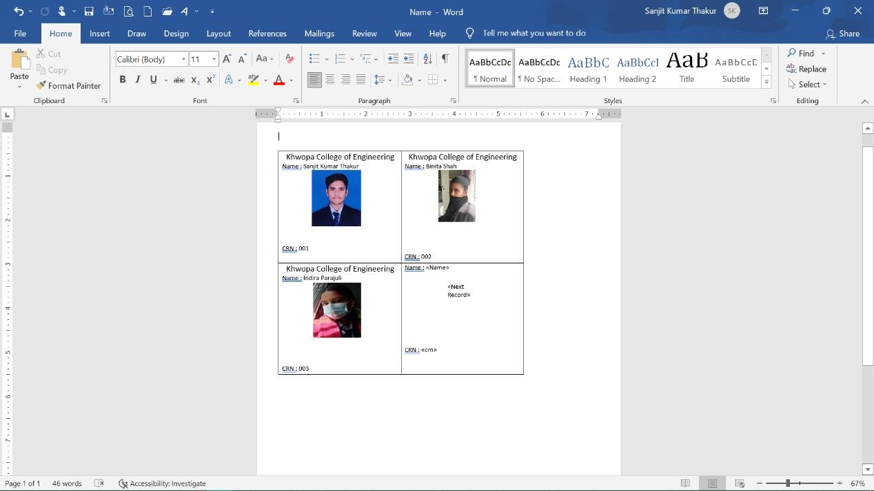
Mail Merge using by templets

Slide 7
Microsoft Excels
Basic of excel
Conditional formatting (E.g. If, VLOOKUP, Concatenate, Upper, Lower, Proper etc.)
Filters, charts
Usage
Data entry (letter registration, letter forwarded, scholarship and so on)
Mail merge
Student details collect and sort on the basis of districts

Slide 8
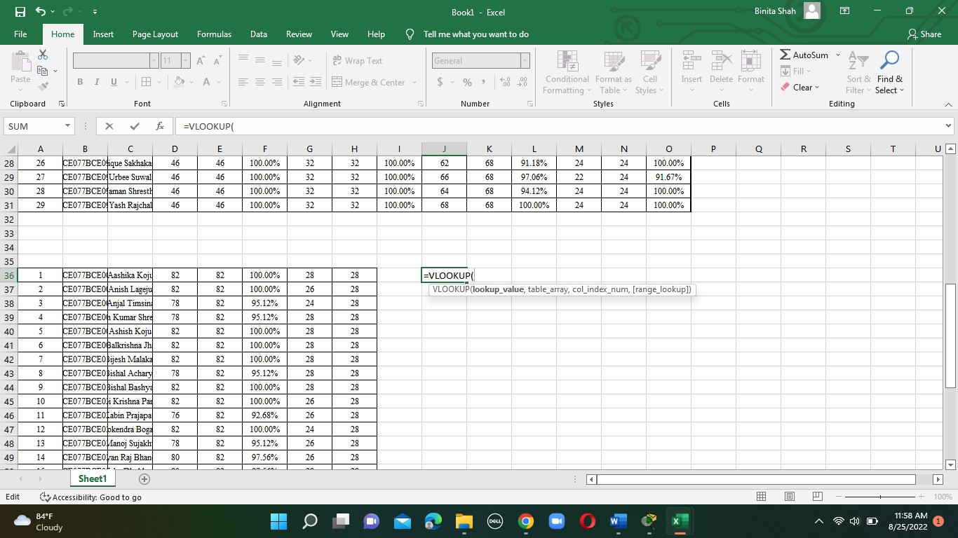
Using VLOOKUP to organize the data

Slide 9
Microsoft PowerPoint
Basics of PowerPoint
Transitions and Animations, use of design templates and so on.
Usage
Preparing presentation and conveying information on the basis of UI, graphs and so on.

Slide 10
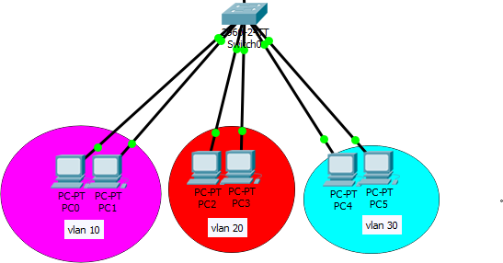
Cisco Design
IP DHCP
Dynamic Host Configuration Protocol is a network protocol used to dynamically assign IP addresses to devices on a network.
Vlan
Virtual Local Area Network s a logical network that can be created on top of a physical network).
Inter Vlan Routing
Inter-VLAN routing is the process of routing traffic between different VLANs (Virtual Local Area Networks).
Creating vlan

Slide 11
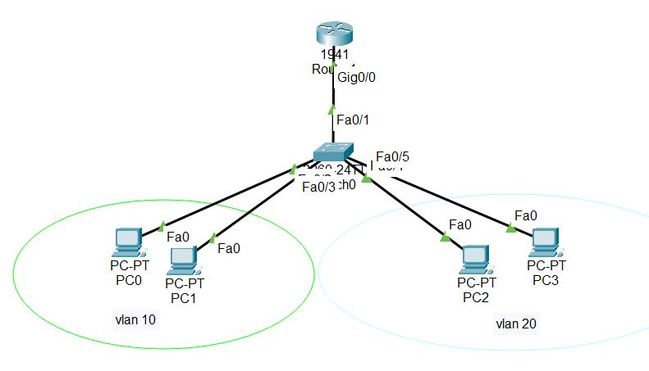
Cisco Design Continue..
Telnet
Telnet is a network protocol that allows a user to connect to a remote computer and access its command-line interface).
Example : Remote Desktop Connection
DNS
Domain Name System server is a server that translates human-readable domain names into numerical IP addresses that computers can understand).
Inter Vlan

Slide 12
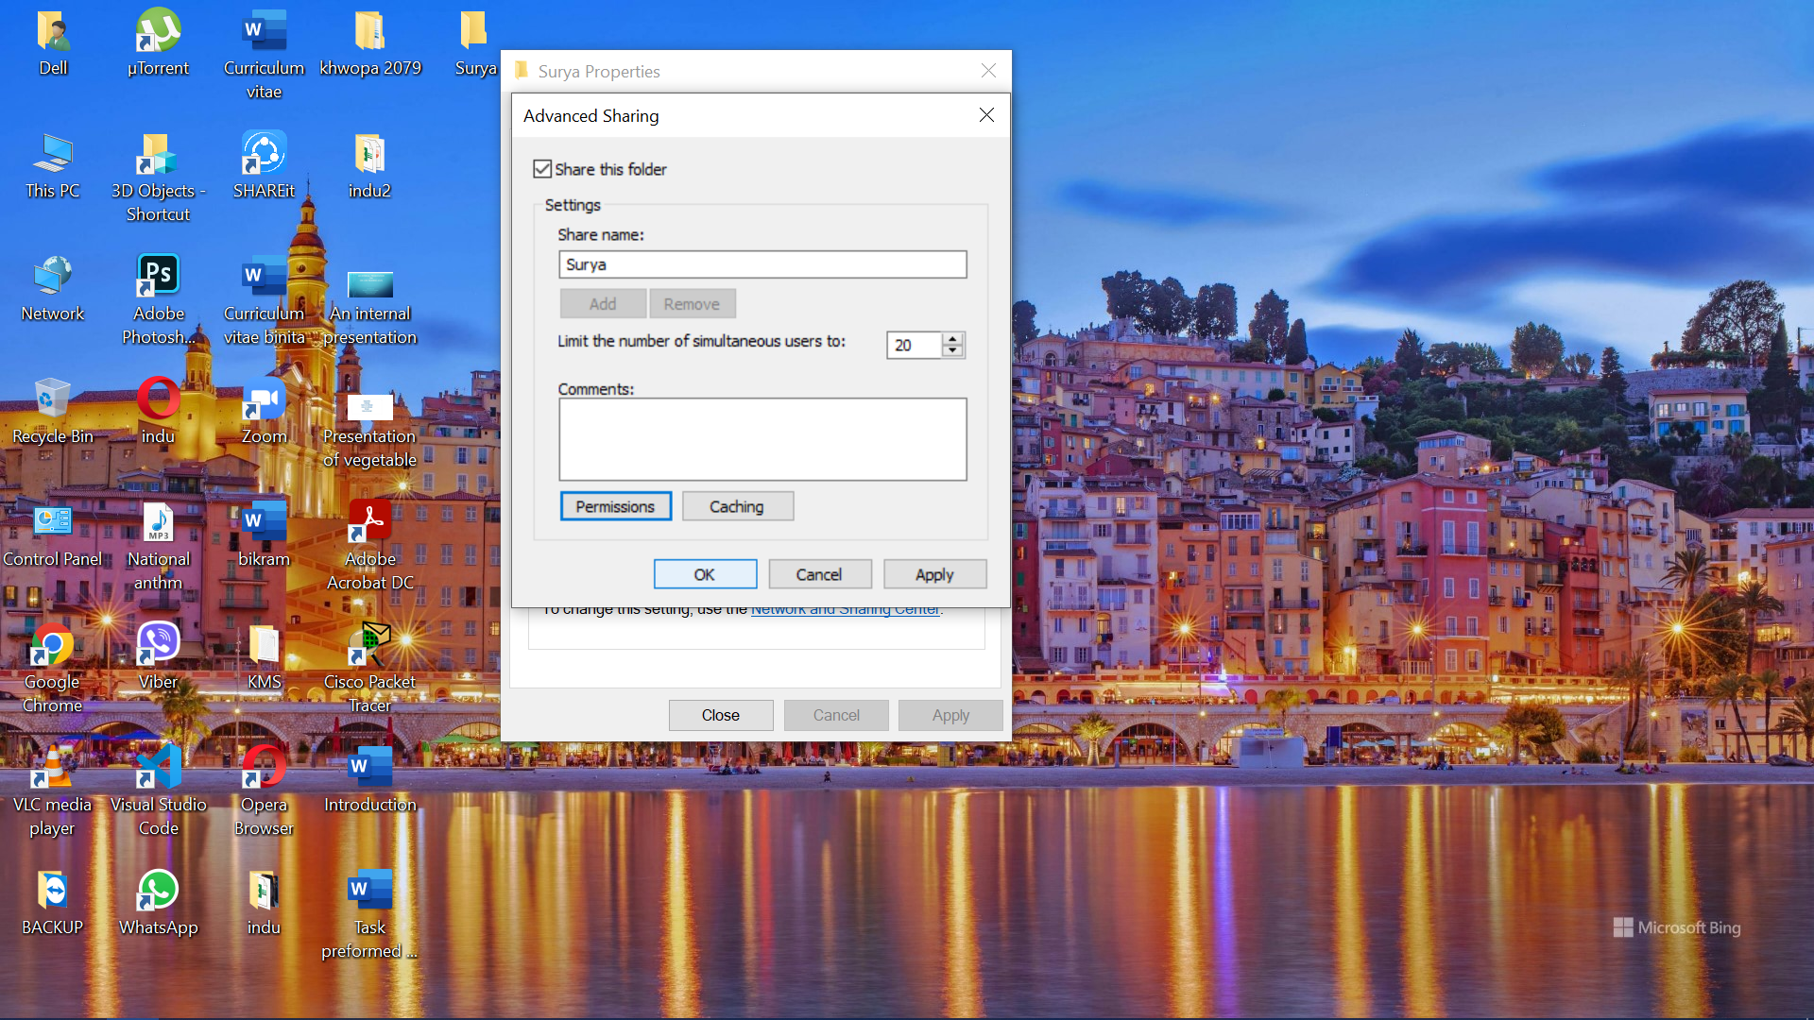
Cisco Design Continue..
Usage
File share in network
CN-pilot router installation

Slide 13
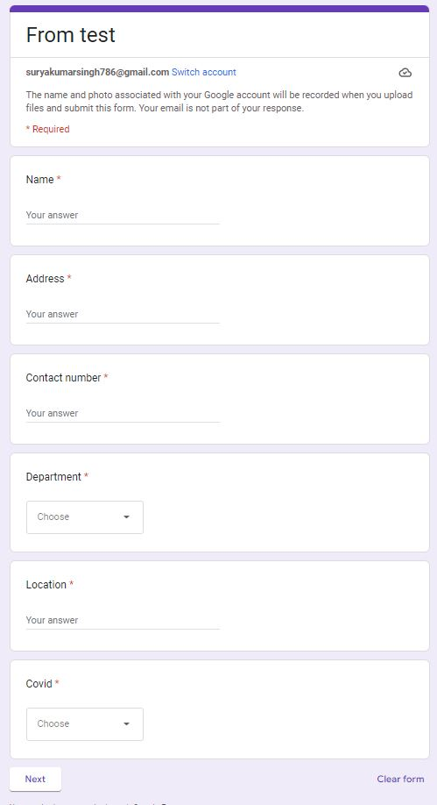
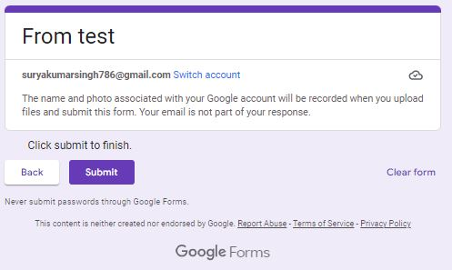
Google Forms
Basics of google form, different question types, data collections
Google Forms is a free online survey and quiz creation tool that is part of Google.
We practiced by creating google forms and sharing the link with the friends.
Google forms created for test

Slide 14
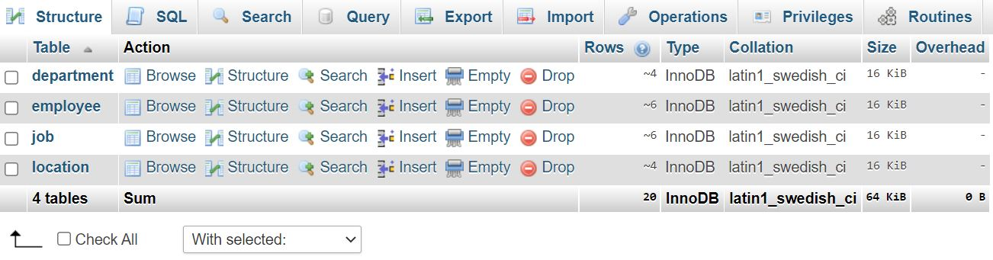
Database Design and Different Operations
Database Creation
Table Creation and Relations Between different tables
CRUD Operation
SQL Query
Join
Sub Query
Aggregate Functions
CREATE TABLE orders (
id int PRIMARY KEY AUTO_INCREMENT,
user_id int,
FOREIGN

Slide 15
Database Continue..
CRUD Operation (CRUD stands for Create, Read, Update, and Delete).
SQL Query
SELECT: Used to retrieve data from the database.(SELECT * FROM users WHERE age > 25;)
INSERT: Used to insert new data into the database.
UPDATE: Used to modify existing data in the database.
DELETE: Used to delete data from the database.
CREATE: Used to create new tables or other objects in the database.

Slide 16
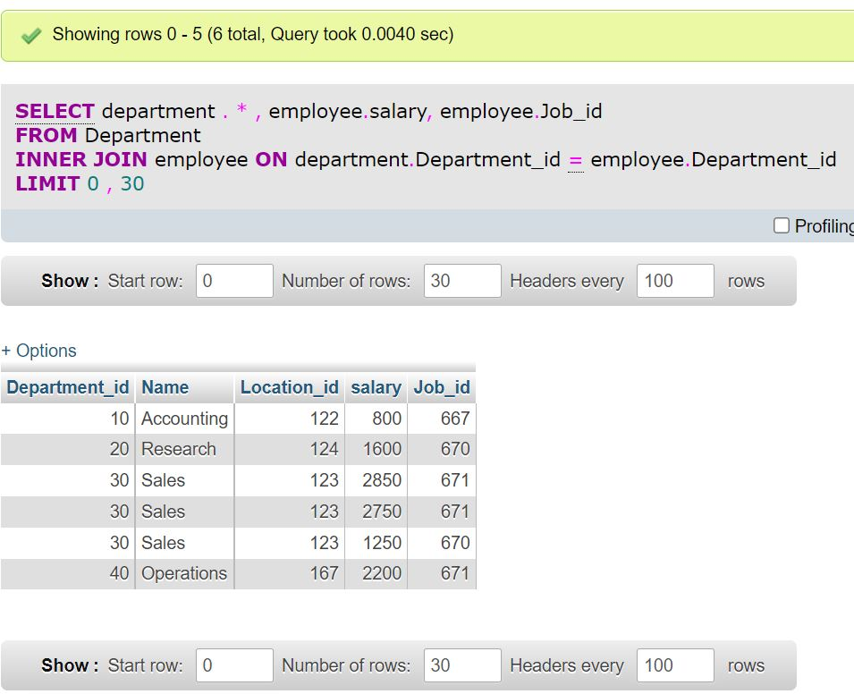

Slide 17
PHP
PHP Syntax, Variables, Echo and Print
Data types (String, Integer, Character, Constant and so on)
Operator, Conditional Statement
Loop, Function, Array & its types, Supper Global Variable, Datetime.
Session & Cookie, Exception Handling
Database and MySQL
Database module generate SQL

Slide 18
Database and MySQL A database management system (DBMS) is software that is used to create and manage databases. MySQL is a popular open-source DBMS that is widely used on the web. It is known for its speed, reliability, and flexibility.
Database Module
Install the necessary software and libraries: Depending on the database module we are using, we installed specific software and libraries in order to use it.
Configure the database module: Once the necessary software and libraries were installed, we need to configure the database module to connect to the DBMS.
Test the connection: After configuring the database module, we test the connection to ensure that it is working properly.

Slide 19
Database Module generate SQL
PHP database module have the ability to generate SQL (Structured Query Language) statements based on user input or other criteria.
SQL is the standard language for interacting with relational databases, and is used to perform various operations such as querying data, inserting, updating, and deleting records, and creating and modifying database objects such as tables and views.

Slide 20
Database Module generate code
public function getCategorybyId($category_id,$is_die=false){
$args = array(
//'fields' => "categoryname, password",
'where' => array(
'or' => array(
'id'=> $category_id,
)
)
);
return $this->getData($args,$is_die);
}

Slide 21
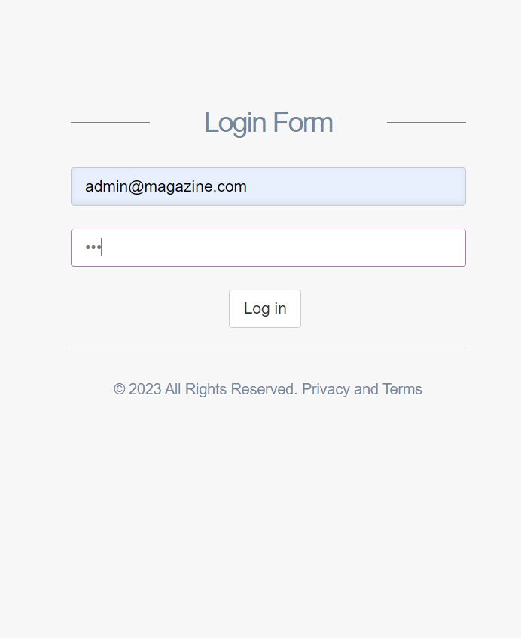
Login Page

Slide 22
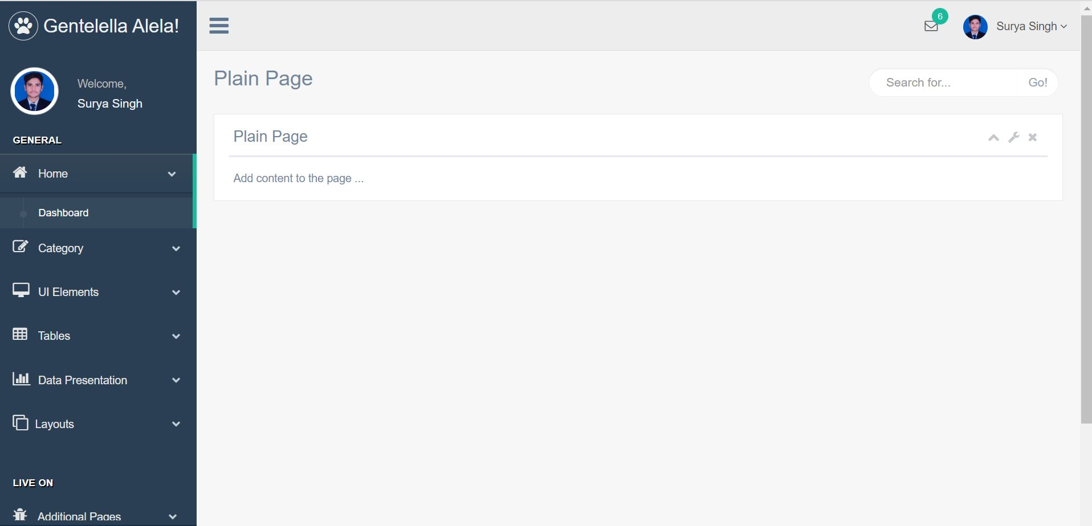
Dashboard After Cleaning

Slide 23
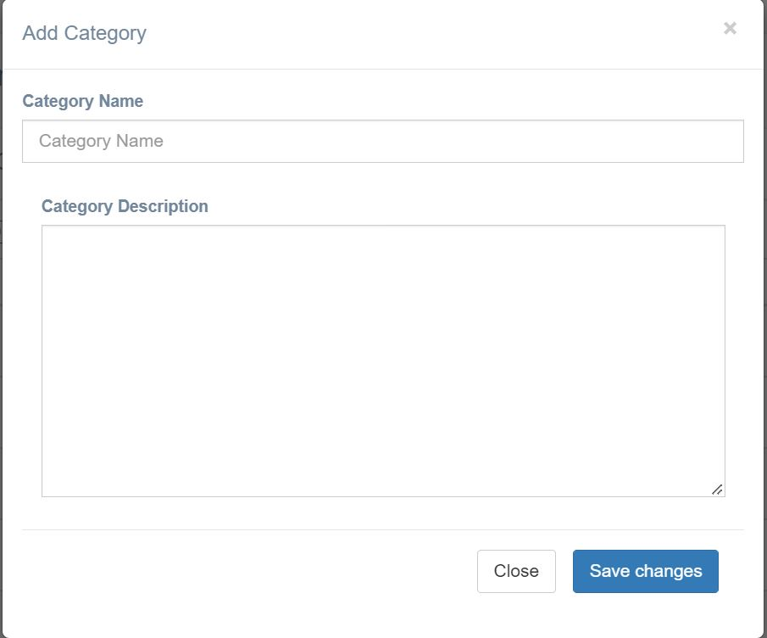
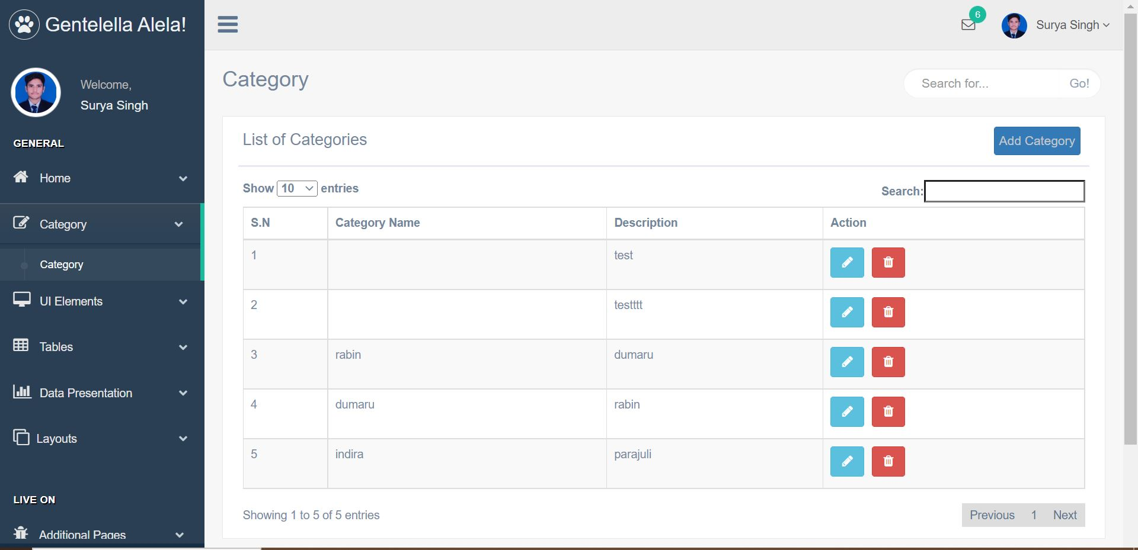
Database add data
Add Category tab

Slide 24
Mathematics Practice for class 12 Back exam
Permutation and Combination
Statistics
Probability
Linear Programming
System of Linear Equations
Numerical Integration

Slide 25
Git
Git bash (we can use it to execute Git commands and perform various tasks such as cloning repositories, creating branches, committing changes, and pushing code to remote servers.)
Project file configuration
Pull & Push (pull and push are two important commands that are used to manage the relationship between a local repository and a remote repository.)
Publish static website
Usage
Publish static website in git account
Store file in GitHub

Slide 26
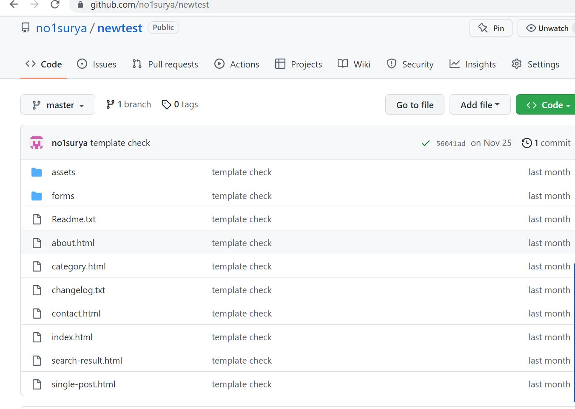
Upload local file in GitHub

Slide 27
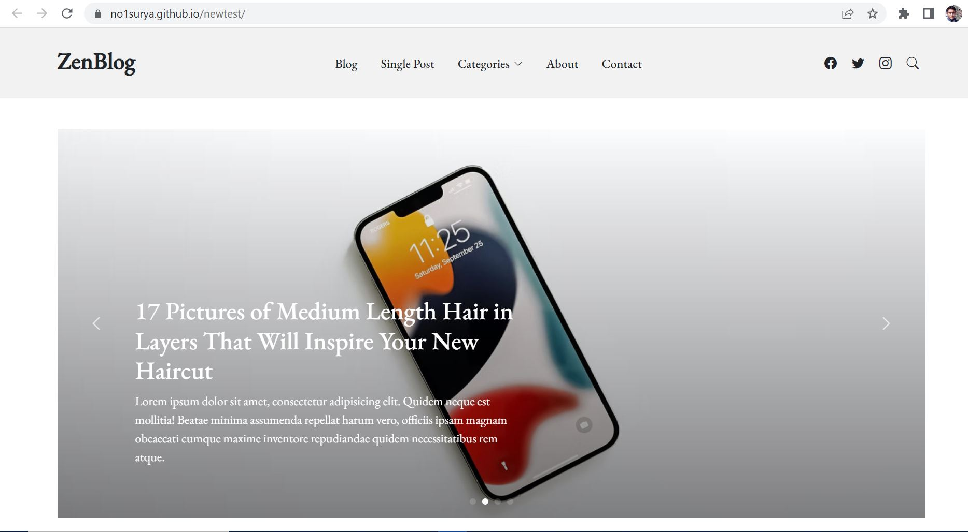
Publish local repo in GitHub

Slide 28
Different Tasks Performed
Document Scanning (Letter Forwarded, Internal Letter Forwarded, Letter Registration, Old Question, Batch 2077 and 2078 all documents)
Data collection and manipulation in Excel (Scholarship data, Final Result Preparation)
QA Testing of KhEC EMIS app (Take attendance of all student, Check assignment)
Windows Activation & Installations in Lab (Block C, F & G)
Assist in IOE Priority Forms
Setup Router for IP camera
Create Teams in MS-Teams for new Session.

Slide 29
Different Tasks Performed Continue…
RJ45 cable connection
Repair computers in labs (Formatting, Windows Installation, Software Installation, Dual Booting, SSD addition, and so on).
Printer Sharing in Network

Slide 30
QA Testing of KhEC EMIS App
The teacher provided us with the login credentials of no. of teachers.
We took attendance on different subject and then checked whether the app was functioning correctly or not.
Login different user profile’s and check if their respective subject has been assigned or not.
Different testing like UI design error, data synchronization, program flow, push notification etc. were carried out.

Slide 31
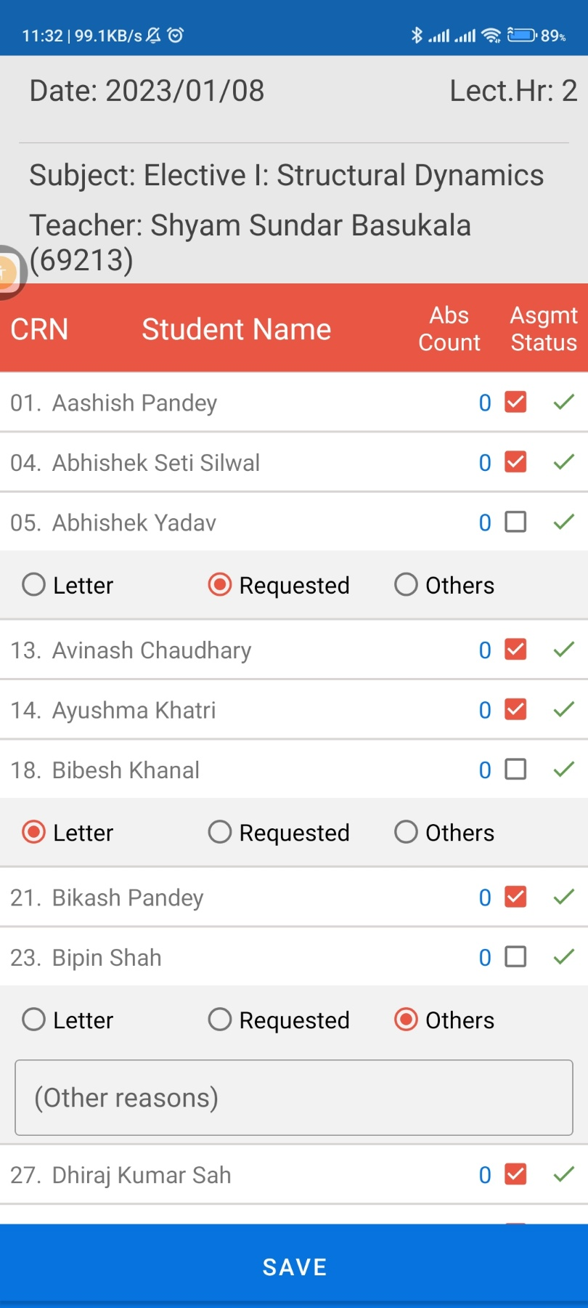
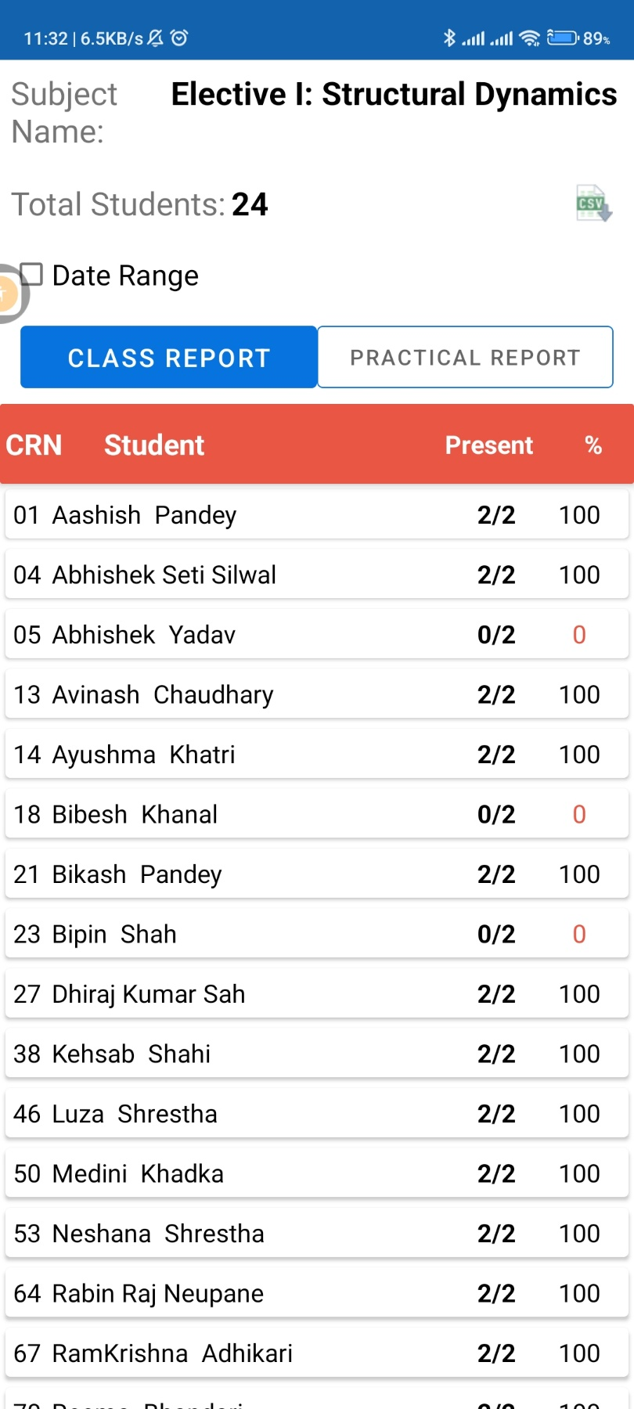
Take attendance of all student
Assignment check

Slide 32
Windows Activation & Installations in Lab
Active Office & Windows in lab
Installation and Removal of programs and other files in computer lab
Software installations in lab
Dual Boot (Windows 10 & Ubuntu 22.0)
Set up computer & printer in Architecture Department (PU) and install all necessary software's.

Slide 33
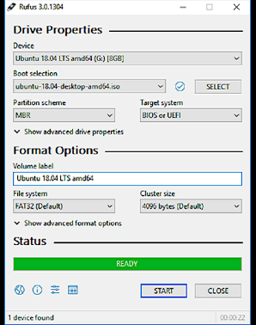
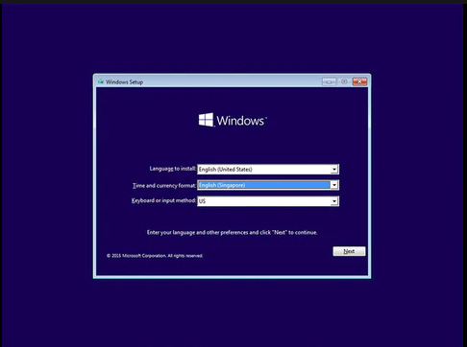
Bootable USB creation
Windows Installation

Slide 34
Assist in IOE Priority Forms
Students had to fill up the Priority Application Form in 4 steps i.e. basic information along with IOE details, citizenship & score card upload, payment & priority selection and general information of applicants along with guardian information.
We assisted to those students who had come to college in order to fill up the form and had difficulty in form fill up.
We mainly helped in the payment process.

Slide 35
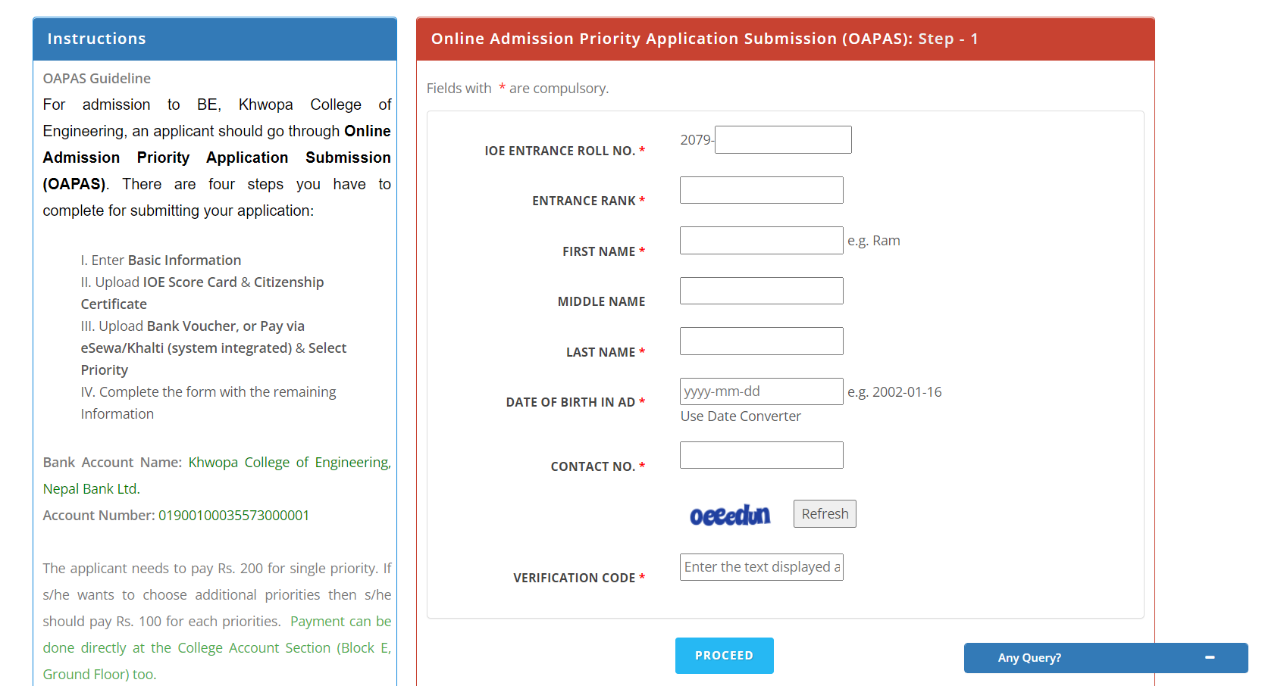
Helps to Fill the priorty forms

Slide 36
Setup Router for IP camera
Router setup for IP camera (Block E lift)
Installation of CN-Pilot Router in Block A
Join IP CCTV
Printer Share in network

Slide 37
Thank You !

